Slide 1
Deep Learning Specialization Hyperparameter Tunning, Batch Norm, and Softmax
(2020 Deeplearning.ai)
YangXi’s Reading Notes

Slide 2
Contents
Hyperparameters Tuning
Coarse-to-Fine Sampling Scheme
Scale of Hyperparameters
Search for Hyperparameters
Batch Normalization
Training Implementation
Why Does Batch Normalization Work?
Batch Norm as Regularization
Testing Implementation
Softmax Regression
Train a Softmax Classifier
Appendix: Hardmax Function

Slide 3
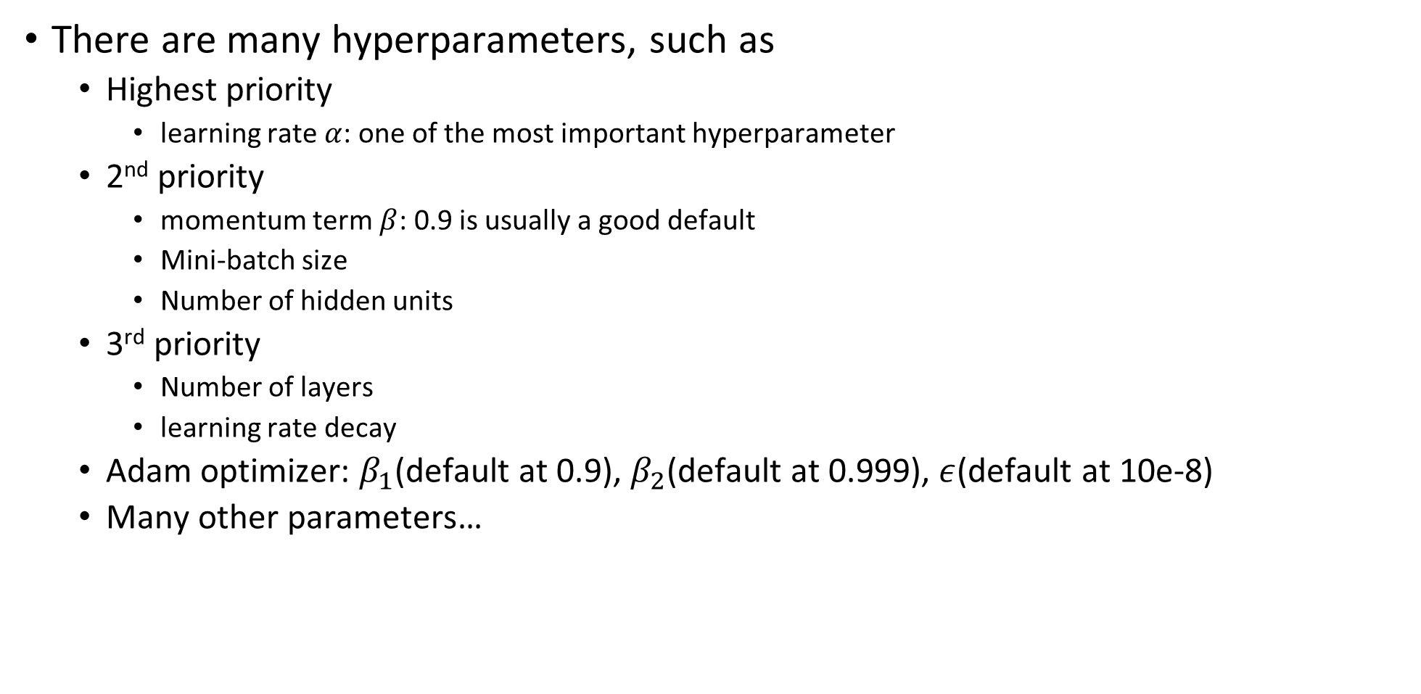
Hyperparameters
There are many hyperparameters, such as
Highest priority
learning rate $α$: one of the most important hyperparameter
2nd priority
momentum term $β$: 0.9 is usually a good default
Mini-batch size
Number of hidden units
3rd priority
Number of layers
learning rate decay
Adam optimizer: $β_{1}$(default at 0.9), $β_{2}$(default at 0.999), $ε$(default at 10e-8)
Many other parameters…

Slide 4
Coarse-to-Fine Sampling Scheme
Grid search: only works when the number of hyperparameters is small
More Recommended
Instead of choosing values with fixed step over a range, choosing random points in the hyperparameters space
The reason is, before hand, you don’t know which hyperparameters affect you model more or less
Certain hyperparameter may have little effect on your model. It is a waste of time to search through a complete grid of such hyperparameters.
Coarse-to-fine sampling scheme
Start with randomly sample from a larger hyperparameter scheme
Observe certain promising sub-space
Zoom in to the sub-space, and sample more from there

Slide 5
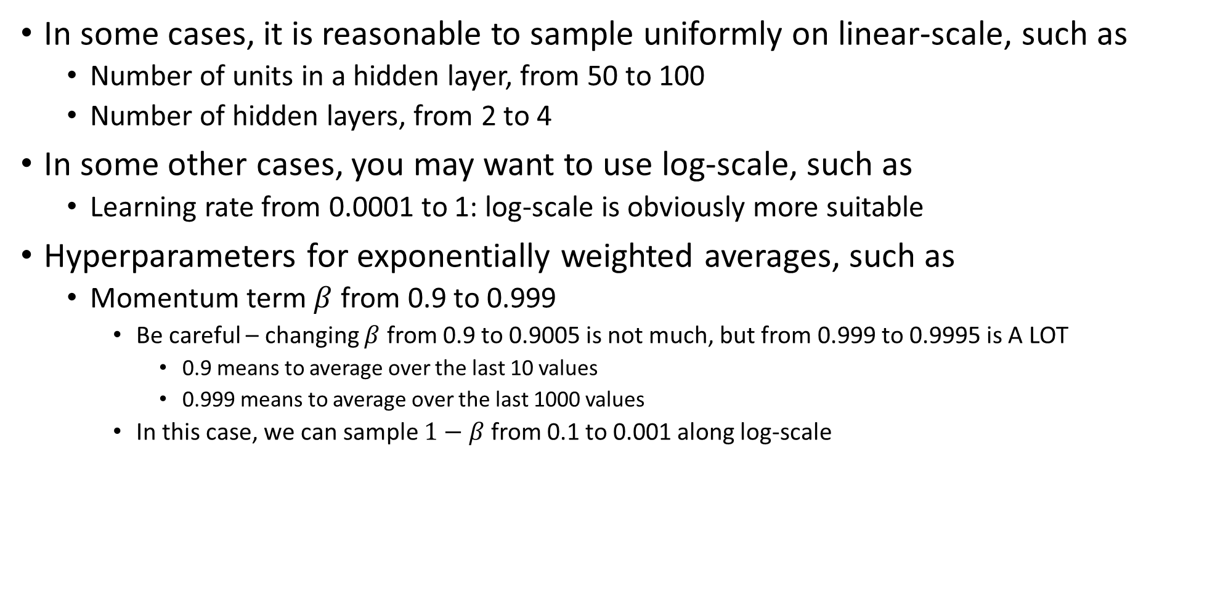
Scale of Hyperparameters
In some cases, it is reasonable to sample uniformly on linear-scale, such as
Number of units in a hidden layer, from 50 to 100
Number of hidden layers, from 2 to 4
In some other cases, you may want to use log-scale, such as
Learning rate from 0.0001 to 1: log-scale is obviously more suitable
Hyperparameters for exponentially weighted averages, such as
Momentum term $β$ from 0.9 to 0.999
Be careful – changing $β$ from 0.9 to 0.9005 is not much, but from 0.999 to 0.9995 is A LOT
0.9 means to average over the last 10 values
0.999 means to average over the last 1000 values
In this case, we can sample $1−β$ from 0.1 to 0.001 along log-scale

Slide 6
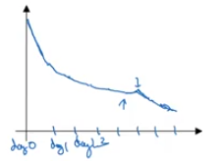
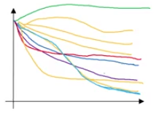
Search for Hyperparameters
Babysit one model
Huge data but limited computation resources
Take days or even weeks for one training cycle
Monitor the performance during training from time-to-time (say, daily), and adjust learning-rate when needed.
More commonly used in domains with big data
Training many models in parallel
If computation resources allow, surely we want to try many models (hyperparameters) at the same time

Slide 7
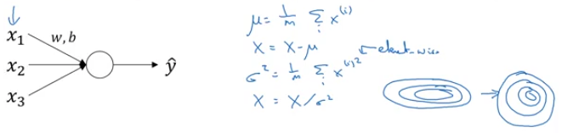
Batch Normalization
An important idea to speed up learning
Easier to train very deep network
Easier hyperparameter search
Make the NN more robust to selection of hyperparameters
Recap: normalizing inputs to speed up learning
Convert learning problem from “elongated” to “round and easier”

Slide 8
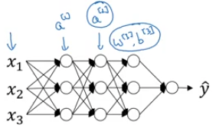
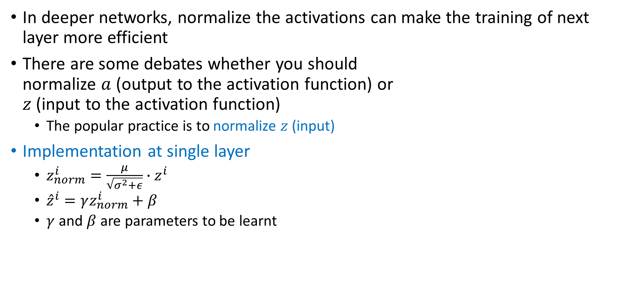
Batch Normalization – Training
In deeper networks, normalize the activations can make the training of next layer more efficient
There are some debates whether you should normalize $a$ (output to the activation function) or $z$ (input to the activation function)
The popular practice is to normalize $z$ (input)
Implementation at single layer
$z_{norm}^{i}=\frac{μ}{\sqrt{σ^{2}+ε}}∙z^{i}$
${\hat{z}}^{i}=γz_{norm}^{i}+β$
$γ$ and $β$ are parameters to be learnt

Slide 9
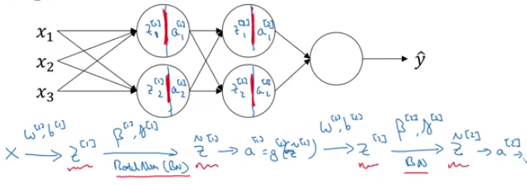
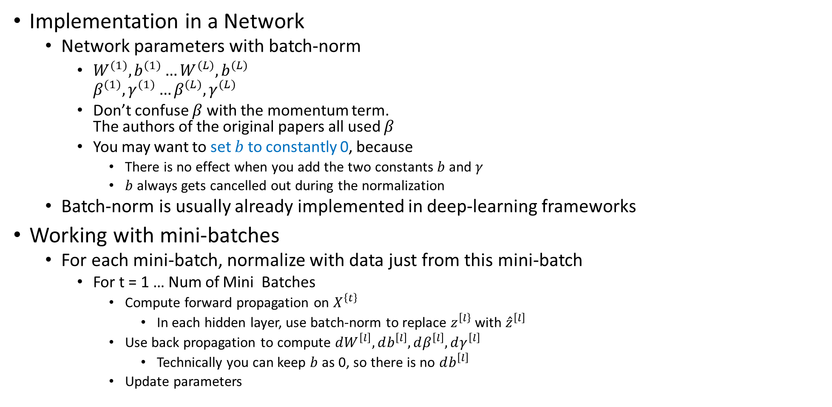
Batch Normalization - Training
Implementation in a Network
Network parameters with batch-norm
$W^{(1)}, b^{(1)}…W^{(L)}, b^{(L)}$ $β^{(1)}, γ^{(1)}…β^{(L)}, γ^{(L)}$
Don’t confuse $β$ with the momentum term. The authors of the original papers all used $β$
You may want to set $b$ to constantly 0, because
There is no effect when you add the two constants $b$ and $γ$
$b$ always gets cancelled out during the normalization
Batch-norm is usually already implemented in deep-learning frameworks
Working with mini-batches
For each mini-batch, normalize with data just from this mini-batch
For t = 1 … Num of Mini Batches
Compute forward propagation on $X^{\left\{t\right\}}$
In each hidden layer, use batch-norm to replace $z^{\left[l\right\}}$ with ${\hat{z}}^{\left[l\right]}$
Use back propagation to compute $dW^{\left[l\right]}, db^{\left[l\right]}, dβ^{\left[l\right]}, dγ^{\left[l\right]}$
Technically you can keep $b$ as 0, so there is no $db^{\left[l\right]}$
Update parameters

Slide 10
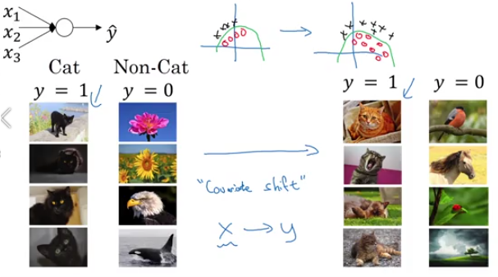
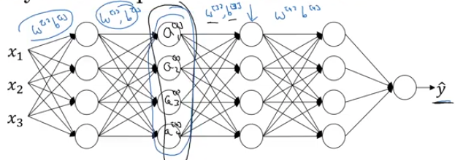
Why Does Batch Normalization Work?
Firstly, similar to how normalizing input features X can speed up training.
Batch-norm also makes weights later in the network more robust to changes of weights in earlier layers.
Covariate shift: shift of input distribution
See example on bottom right
Say we look at the “sub-network” of the last two hidden layers and the output layer, the inputs to this “sub-network” will keep on changing during training
This caused the problem of covariate shift
With batch-norm, the input will still change, but keep the mean and variance the same
By doing so, batch-norm reduces the problem of covariate shift

Slide 11
Batch Norm as Regularization
Batch-norm also has a slight regularization effect
Each mini-batch is scaled by the mean/variance computed on just that mini-batch
Because the mean and variance are not computed on the entire dataset, their values contain some noise
So similar to dropout, mini-batch added some noise to each hidden layer’s activations
By using bigger mini-batch, you will reduce this regularization effect
This regularization is a side-effect of batch-norm, which is no the key purpose.
You would use other methodologies for regularization purpose.

Slide 12
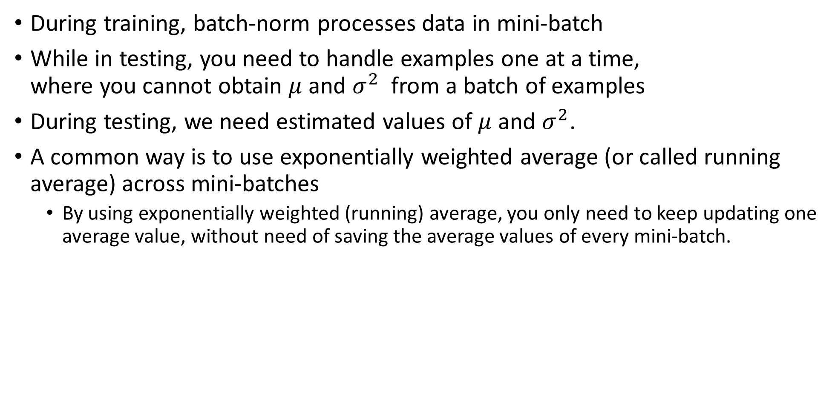
Batch Normalization - Testing
During training, batch-norm processes data in mini-batch
While in testing, you need to handle examples one at a time, where you cannot obtain $μ$ and $σ^{2}$ from a batch of examples
During testing, we need estimated values of $μ$ and $σ^{2}$.
A common way is to use exponentially weighted average (or called running average) across mini-batches
By using exponentially weighted (running) average, you only need to keep updating one average value, without need of saving the average values of every mini-batch.

Slide 13
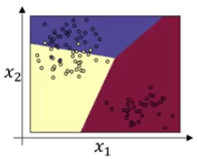
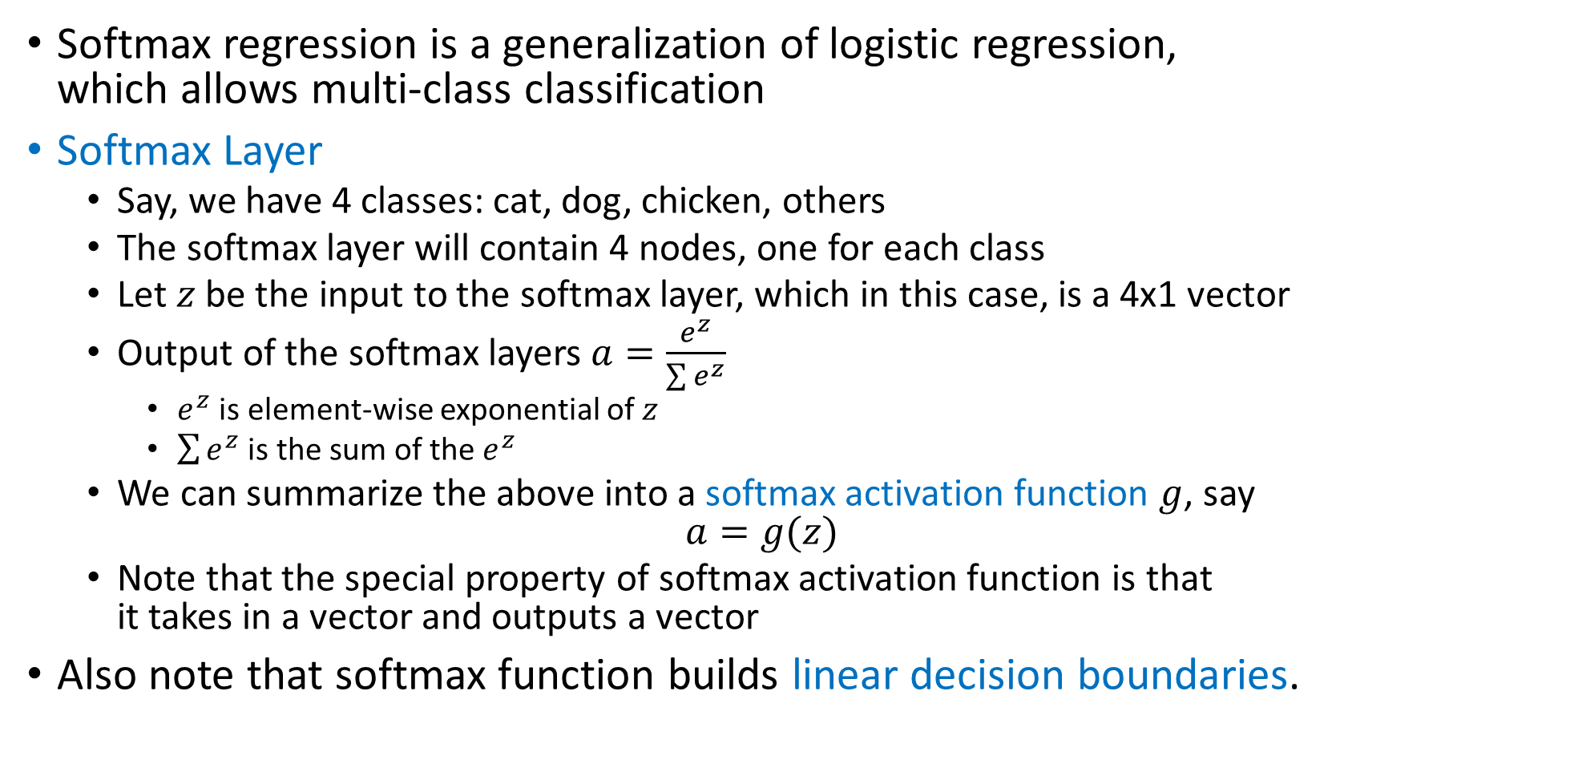
Softmax Regression
Softmax regression is a generalization of logistic regression, which allows multi-class classification
Softmax Layer
Say, we have 4 classes: cat, dog, chicken, others
The softmax layer will contain 4 nodes, one for each class
Let $z$ be the input to the softmax layer, which in this case, is a 4x1 vector
Output of the softmax layers $a=\frac{e^{z}}{\sum{e^{z}}}$
$e^{z}$ is element-wise exponential of $z$
$\sum{e^{z}}$ is the sum of the $e^{z}$
We can summarize the above into a softmax activation function $g$, say $a=g(z)$
Note that the special property of softmax activation function is that it takes in a vector and outputs a vector
Also note that softmax function builds linear decision boundaries.

Slide 14
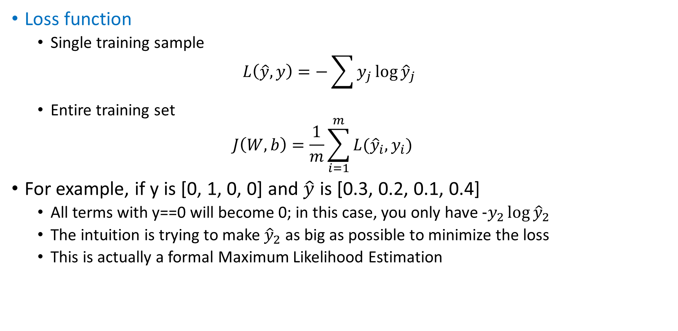
Train a Softmax Classifier
Loss function
Single training sample $L\left(\hat{y},y\right)=−\sum{y_{j}\log{{\hat{y}}_{j}}}$
Entire training set $J\left(W,b\right)=\frac{1}{m}\sum_{i=1}^{m}{L({\hat{y}}_{i},y_{i})}$
For example, if y is [0, 1, 0, 0] and $\hat{y}$ is [0.3, 0.2, 0.1, 0.4]
All terms with y==0 will become 0; in this case, you only have $-y_{2}\log{{\hat{y}}_{2}}$
The intuition is trying to make ${\hat{y}}_{2}$ as big as possible to minimize the loss
This is actually a formal Maximum Likelihood Estimation

Slide 15
Appendix: Hardmax Function
This is a side note. There is also a hardmax function
Similar to softmax, it takes a vector as input, and outputs a vector
The output vector is simply 1 and many 0, where 1 is at the position of the maximum element in the input vector
For example, if input is [5, 2, -1, 3], the output will be [1, 0, 0, 0]

